Slide 1
DIGITAL PORTFOLIO STUDENT NAME:SALONI DAKALIA REGISTER NO&NMID:2428C0212 &asbruaj2428C0212 DEPARTMENT:SCHOOL OF COMPUTER SCIENCE COLLEGE:AVP COLLEGE OF ARTS AND SCIENCE AFFILIATED BY BHARATHIYAR UNIVERSITY

Slide 2
PROJECT TITLE STUDENT DIGITAL PORTFOLIO

Slide 3
AGENDA 1.PROBLEM STATEMENT 2.PROJECT OVERVIEW 3.WHO ARE THE END USERS 4.FEATURES AND FUNCTIONALITY 5.RESULTS AND SCREENSHOTS 6.CONCLUSION

Slide 4
PROBLEM STATEMENT Without a structural digital portfolio system Students are struggle to demonstrate their competencies beyond grades and certificates Teachers and Mentors lack a centralized tool to evaluate student progress over time

Slide 5
PROJECT OVERVIEW
THE STUDENTS DIGITAL PORTFOLIO IS A DYNAMIC
PLATFORM THAT EMPOWERS LEARNERS TO
SHOWCASE THEIR ACADEMIC ACHIEVEMENTS,
SKILLS, AND PERSONAL GROWTH IN AN
INTERACTIVE AND PROFESSIONAL WAY, BRIDGING
THE GAP BETWEEN TRADITIONAL RECORDS AND
MODERN

Slide 6
WHO ARE THE END USERS
Designed for the students to showcase growth, educators to track progress, and parents to witness achievements all in one seamless platform

Slide 7
TOOLS AND TECHNIQUES
Tools-Technics
Codepen-Organize project clearly
GitHub-Showcase live demonstrates
GitHub pages-Maintain consistency
Google/Drive-keep it updated

Slide 8
FEATURES &FUNCTIONALITY 1.Project showcase 2.Interactive and accessible 3.Professionals connectivity

Slide 9
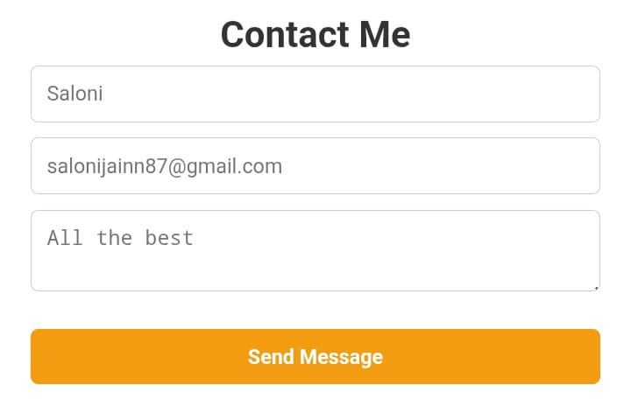
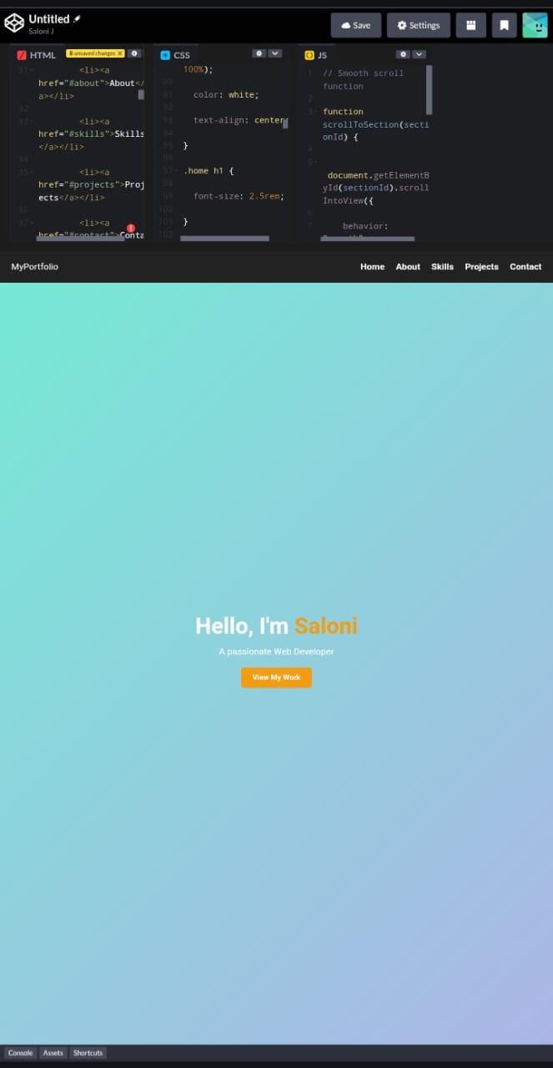
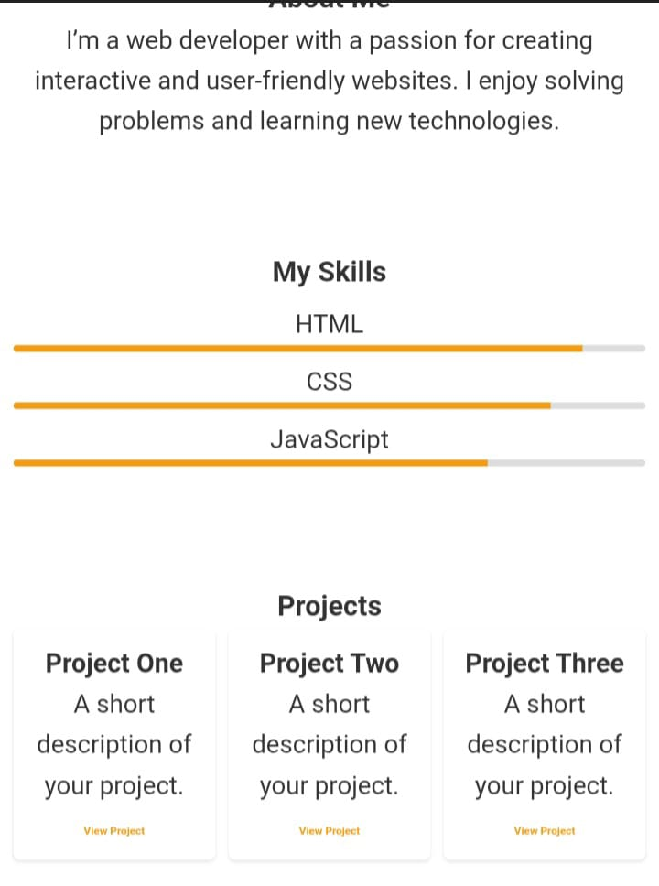
RESULT AND SCREENSHOT

Slide 10
CONCLUSION This portfolio highlights my growth, skills, and creativity as a learner. It reflects my progress so far and my commitment to keep learning, improving, and taking on new challenges in the future

Slide 11
Thank you

